Slide 1
Network Programming
Java Review

Slide 2
Content
Loops
Methods
Arrays
Objects and Classes
Exceptions
Text I/O
Binary I/O
Multithreading

Slide 3
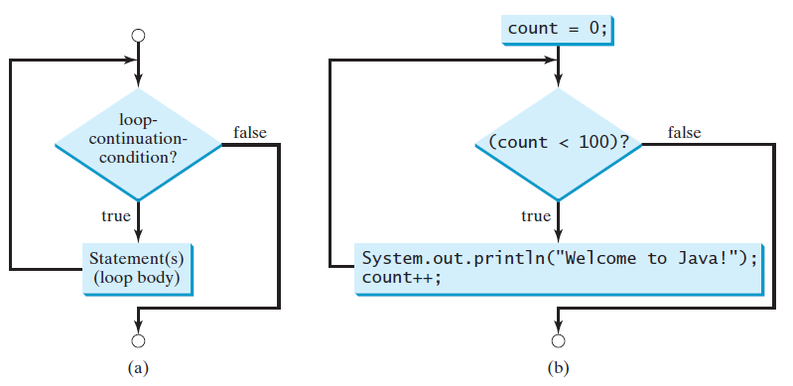
Loops
While
do …while
for
while (loop-continuation-condition) {
// Loop body
Statement(s);
}

Slide 4
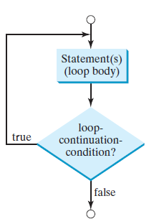
Loops
While
do …while
for
do {
// Loop body;
Statement(s);
} while (loop-continuation-condition);

Slide 5
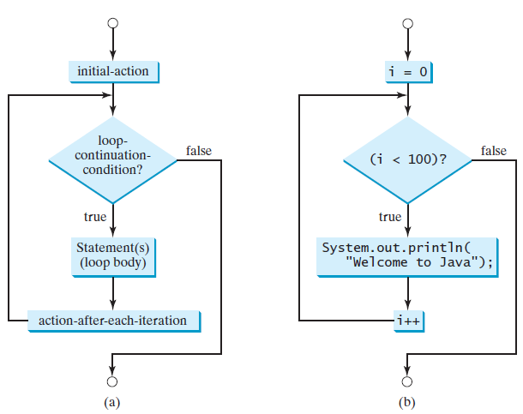
Loops
While
do …while
for
for (initial-action; loop-condition; action-after-each-iteration) {
// Loop body;
Statement(s);
}

Slide 6
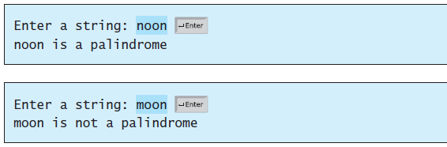




Loops
Case Study: Checking Palindromes

Slide 7
Content
Loops
Methods
Arrays
Objects and Classes
Exceptions
Text I/O
Binary I/O
Multithreading

Slide 8
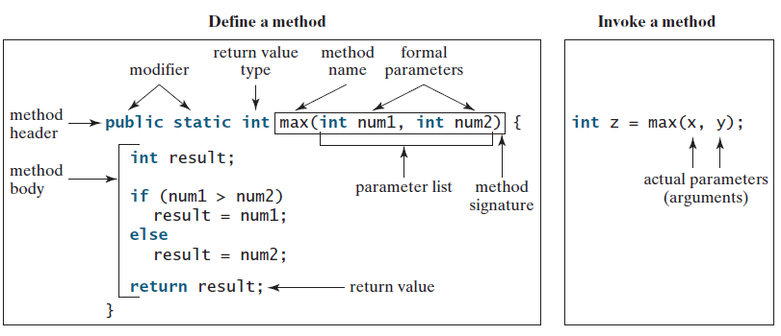
Methods
To define a method:
modifier returnValueType methodName(list of parameters) {
// Method body;
}

Slide 9
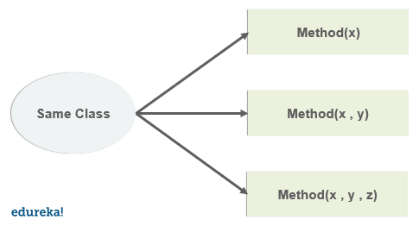
Methods
Overloading methods enables you to define the methods with the same name as long as their signatures are different.

Slide 10
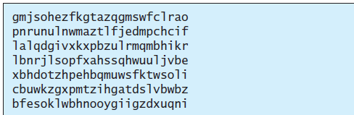
Methods
Case Study: Generating Random Characters

Slide 11
Content
Loops
Methods
Arrays
Objects and Classes
Exceptions
Text I/O
Binary I/O
Multithreading

Slide 12
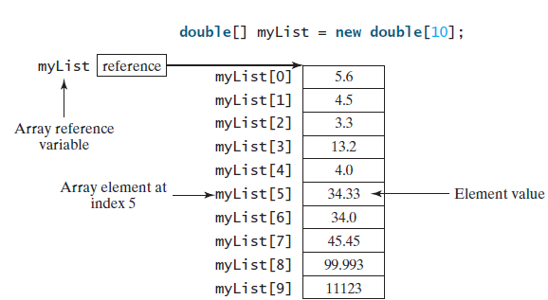
Arrays
A single array variable can reference a large collection of data.
Once an array is created, its size is fixed.
An array reference variable is used to access the elements in an array using an index.
for (elementType element: arrayRefVar) {
// Process the element
}

Slide 13
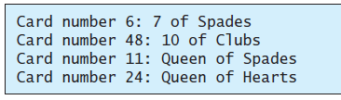
Arrays
Case Study: Deck of Cards

Slide 14
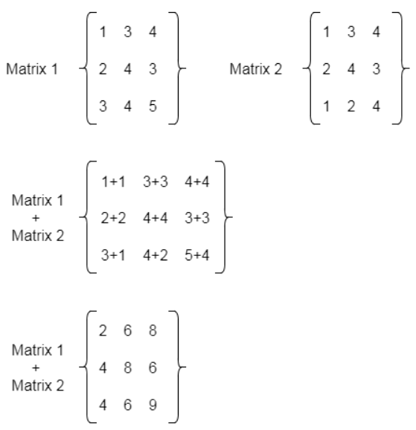
Arrays
Case Study: Addition of 2D Matrices

Slide 15
Content
Loops
Methods
Arrays
Objects and Classes
Exceptions
Text I/O
Binary I/O
Multithreading

Slide 16
Objects and Classes
OOP Concepts
Object
An entity that has attributes and methods
Class
The blueprint that describes objects
Encapsulation
When an object exposes the selected information only
Inheritance
Abstraction
Polymorphism
Objects can inherit other attributes and behaviors from other objects
Hide complex details to reduce complexity
Objects can have more than one form

Slide 17
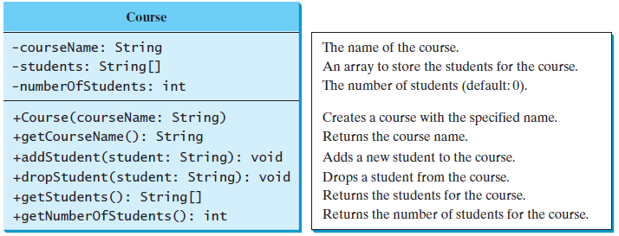
Objects and Classes
Case Study: Designing the Course Class

Slide 18
Content
Loops
Methods
Arrays
Objects and Classes
Exceptions
Text I/O
Binary I/O
Multithreading

Slide 19
Exceptions
Exceptions are error messages thrown from a method.
The caller of the method can catch and handle the exception.
Different ways for handling runtime errors: Quotient.java

Slide 20
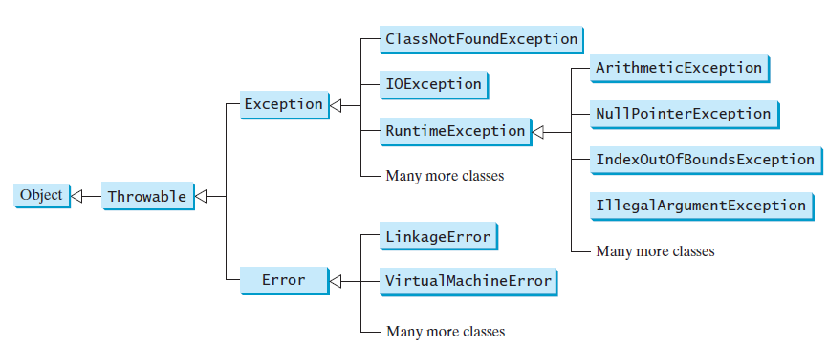
Exceptions
try {
Code to run;
A statement or a method that may throw an exception;
}
catch (type ex) {
Code to process the exception;
}

Slide 21
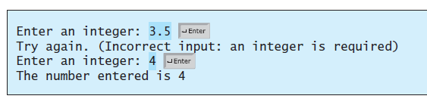
Exceptions
InputMismatchExceptionDemo

Slide 22
Checkpoints
What is the advantage of using exception handling?
Which of the following statements will throw an exception?
Point out the problem in the following code. Does the code throw any exceptions?
System.out.println(1 / 0);
System.out.println(1.0 / 0);
long value = Long.MAX_VALUE + 1;
System.out.println(value);

Slide 23
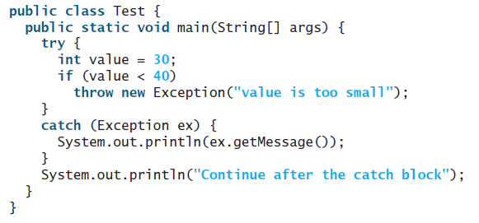
Checkpoints
What does the JVM do when an exception occurs? How do you catch an exception?
What is the output of the following code?

Slide 24
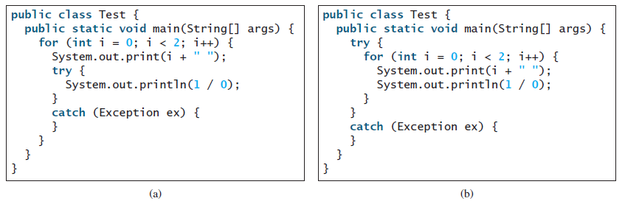
Checkpoints
Show the output of the following code.

Slide 25
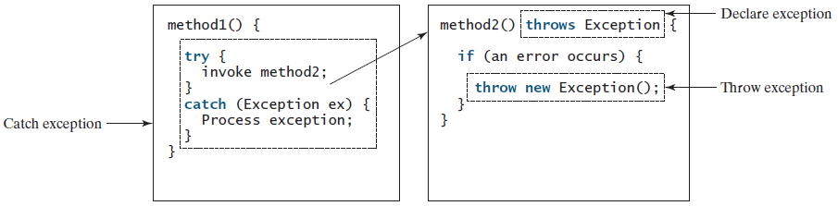
Exceptions
Java’s exception-handling model is based on three operations:
declaring an exception,
throwing an exception,
catching an exception

Slide 26

Exceptions
Declaring exceptions for methods uses $throws$ keyword with method’s header
public void myMethod() throws IOException
public void myMethod()
throws Exception1, Exception2, ..., ExceptionN

Slide 27

Exceptions
Throwing exceptions uses $throw$ keyword in the method’s body
IllegalArgumentException ex =
new IllegalArgumentException("Wrong Argument");
throw ex;
throw new IllegalArgumentException("Wrong Argument");

Slide 28
Exceptions
Catching exceptions
try {
statements; // Statements that may throw exceptions
}
catch (Exception1 exVar1) {
handler for exception1;
}
catch (Exception2 exVar2) {
handler for exception2;
}
...
catch (ExceptionN exVarN) {
handler for exceptionN;
}

Slide 29
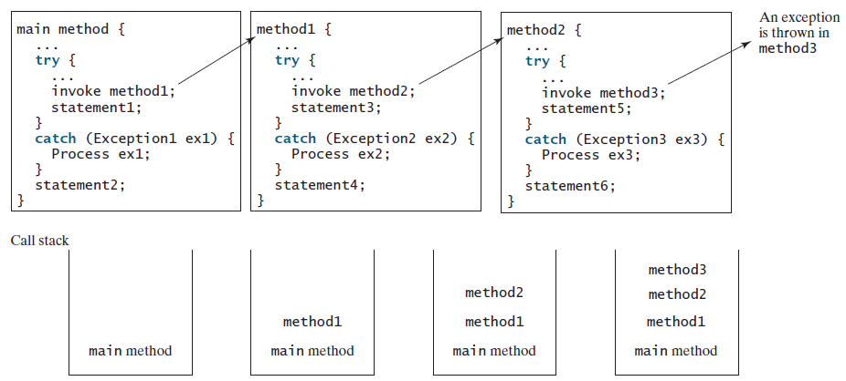
Exceptions
If an exception is not caught in the current method, it is passed to its caller. The process is repeated until the exception is caught or passed to the main method.

Slide 30
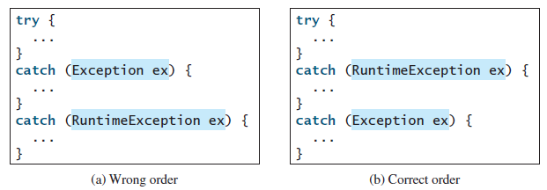
Exceptions
The order in which exceptions are specified in catch blocks is important.
A compile error will result if a catch block for a superclass type appears before a catch block for a subclass type.

Slide 31
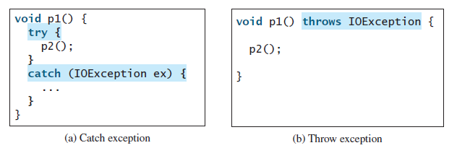

Exceptions
Java forces you to deal with checked exceptions.
checked exception is an exception other than $Error$ or $RuntimeException$
If a method declares a checked exception, you must invoke it in a try-catch block or declare to throw the exception in the calling method.

Slide 32
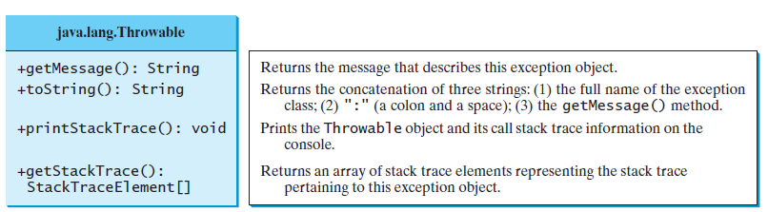
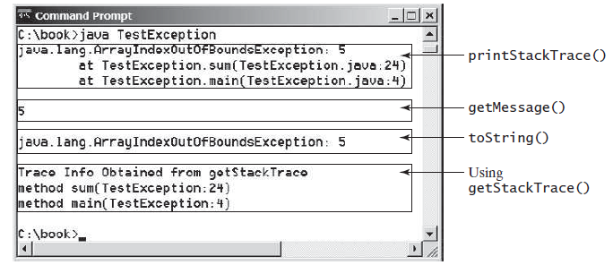
Exceptions
Getting Information from Exceptions

Slide 33

Exceptions
Example: Declaring, Throwing, and Catching Exceptions
CircleWithException

Slide 34

Checkpoints
What is a checked exception, and what is an unchecked exception?
Suppose that $statement2$ causes an exception in the following try-catch block: Answer the following questions:
Will $statement3$ be executed?
If the exception is not caught, will $statement4$ be executed?
If the exception is caught in the catch block, will $statement4$ be executed?
try {
statement1;
statement2;
statement3;
}
catch (Exception1 ex1) {
}
catch (Exception2 ex2) {
}
statement4;

Slide 35
Checkpoints
Correct a compile error in the following code:
public void m(int value) {
if (value < 40)
throw new Exception("value is too small");
}

Slide 36

Exceptions
The $finally$ clause is always executed regardless whether an exception occurred or not.
try {
statements;
}
catch (TheException ex) {
handling ex;
}
finally {
finalStatements;
}

Slide 37
Content
Loops
Methods
Arrays
Objects and Classes
Exceptions
Text I/O
Binary I/O
Multithreading

Slide 38
Text I/O
Files can be classified as either text or binary.
A file that can be processed (read, created, or modified) using a text editor such as Notepad is called a text file.
All the other files are called binary files.
You cannot read binary files using a text editor—they are designed to be read by programs.
Java source programs are text files and can be read by a text editor,
but Java class files are binary files and are read by the JVM.

Slide 39
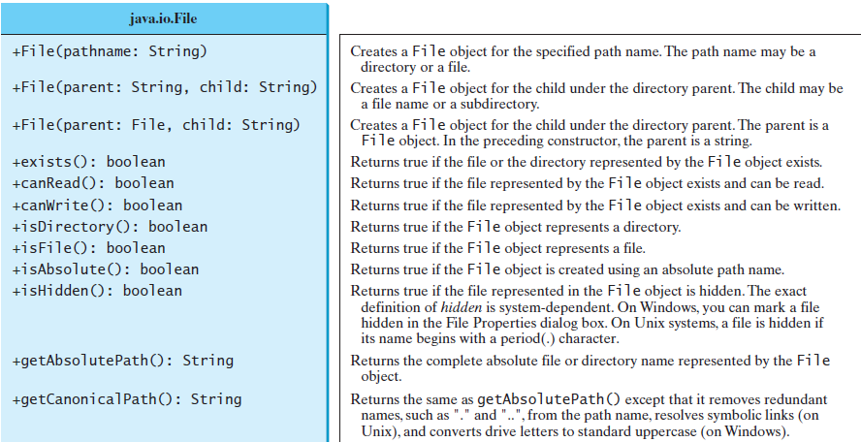

Text I/O
The $File$ class contains the methods for obtaining the properties of a file/directory and for renaming and deleting a file/directory.

Slide 40
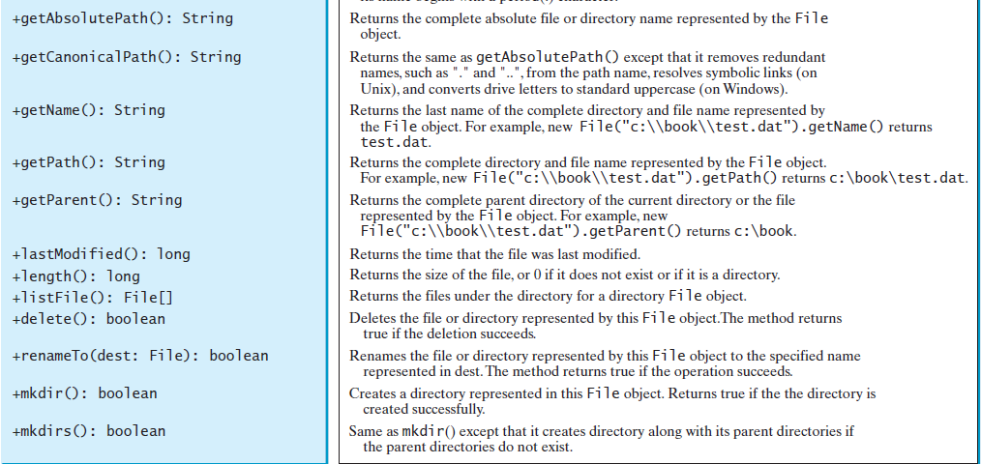
Text I/O

Slide 41
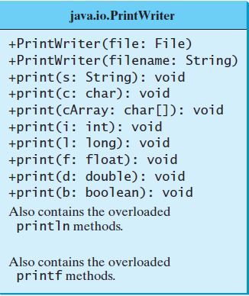

Text I/O
Text data are read using the $Scanner$ class.
Text data written using the $PrintWriter$ class.
PrintWriter output = new PrintWriter("temp.txt");
output.print("Java 101");
output.close();
Scanner input = new Scanner(new File("temp.txt"));
System.out.println(input.nextLine());

Slide 42
Content
Loops
Methods
Arrays
Objects and Classes
Exceptions
Text I/O
Binary I/O
Multithreading

Slide 43
Binary I/O
Files can be classified as either text or binary.
A file that can be processed (read, created, or modified) using a text editor such as Notepad is called a text file.
All the other files are called binary files.
You cannot read binary files using a text editor—they are designed to be read by programs.
Java source programs are text files and can be read by a text editor,
but Java class files are binary files and are read by the JVM.

Slide 44
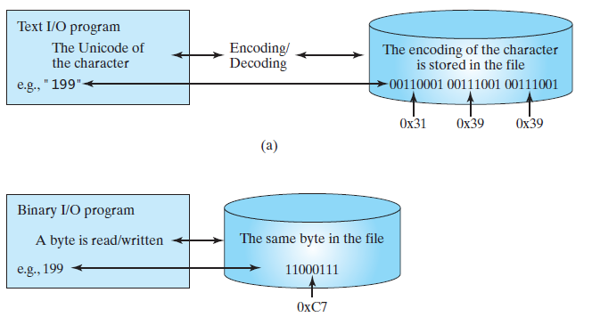
Binary I/O
Binary I/O does not involve encoding or decoding.
Computers do not differentiate between binary files and text files.
All files are stored in binary format, and thus all files are essentially binary files.
Text I/O is built upon binary I/O to provide a level of abstraction for character encoding and decoding

Slide 45
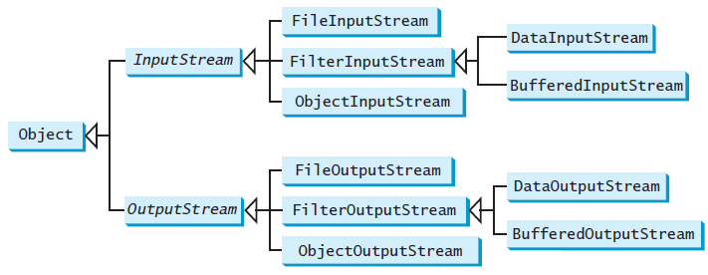

Binary I/O
The abstract $InputStream$ is the root class for reading binary data.
The abstract $OutputStream$ is the root class for writing binary data.
An input object reads a stream of data from a file.
Also called an input stream.
An output object writes a stream of data to a file.
Also called an output stream.

Slide 46
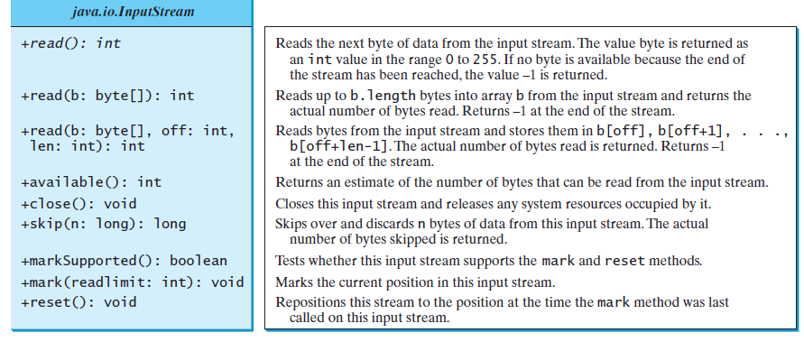
Binary I/O

Slide 47
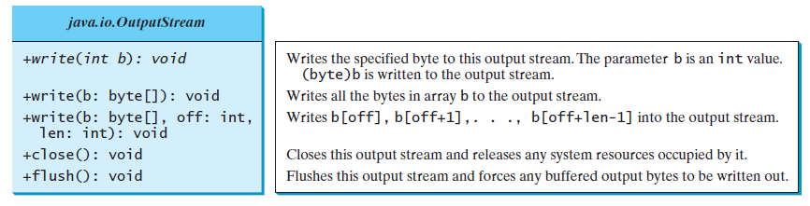
Binary I/O

Slide 48


Binary I/O
Example: uses binary I/O to write ten byte values from 1 to 10 to a file named $temp.dat$ and reads them back from the file.
FileStream.java

Slide 49
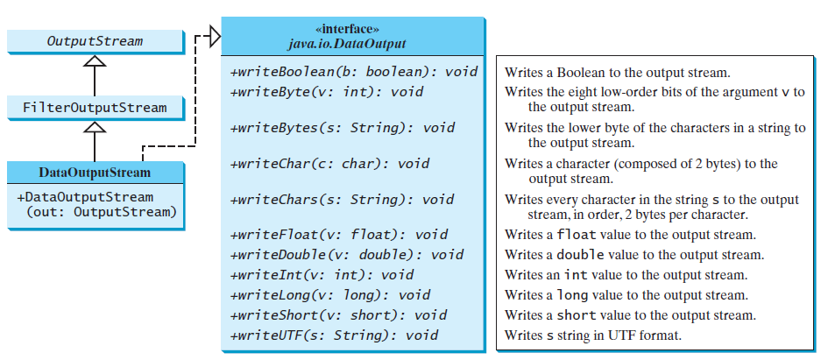

Binary I/O
$DataInputStream$ reads bytes from the stream and converts them into appropriate primitive-type values or strings.
$DataOutputStream$ converts primitive-type values or strings into bytes and outputs the bytes to the stream.
Example: Write students data (DataFileStream)

Slide 50
Content
Loops
Methods
Arrays
Objects and Classes
Exceptions
Text I/O
Binary I/O
Multithreading

Slide 51
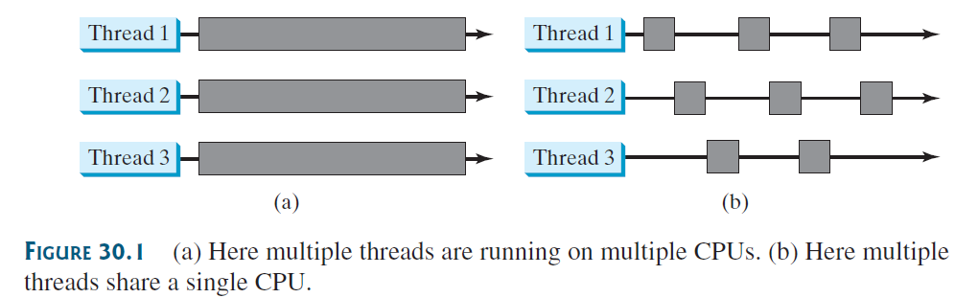
Multithreading
Multithreading enables multiple tasks in a program to be executed concurrently.
A thread provides the mechanism for running a task.
You can launch multiple threads from a program concurrently.
These threads can be executed simultaneously in multiprocessor systems.

Slide 52
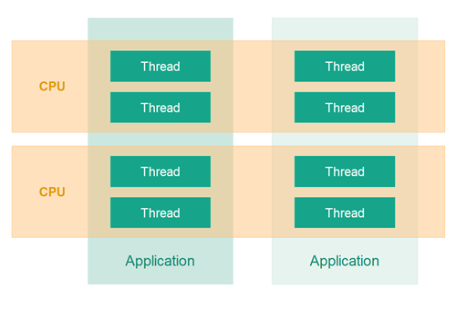

Multithreading
In Java, each task is an instance of the $Runnable$ interface.
Also called a $runnable object$.
A $thread$ is an object that facilitates the execution of a task.

Slide 53
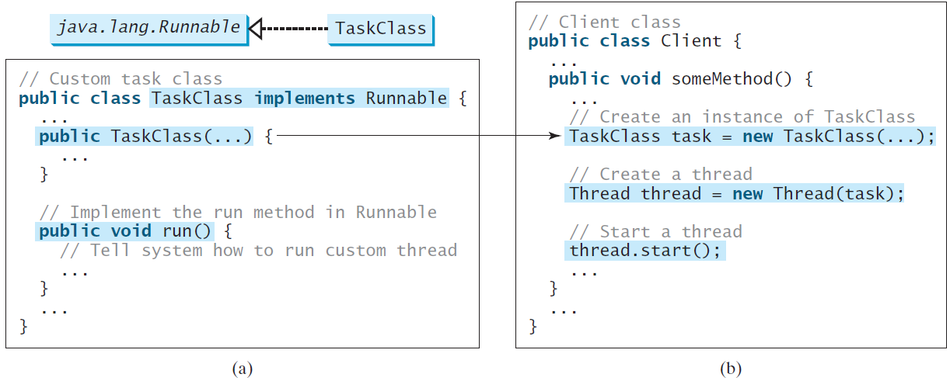

Multithreading
To create tasks, you must first define a class for tasks, which implements the $Runnable$ interface.

Slide 54
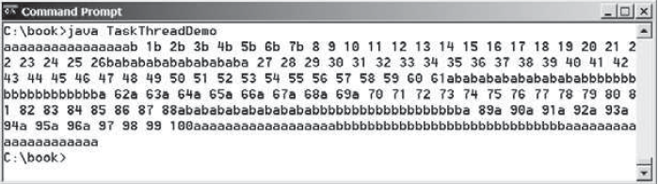
Multithreading
Example: TaskThreadDemo.java

Slide 55

Multithreading
The $run()$ method in a task specifies how to perform the task.
This method is automatically invoked by the JVM. You should not invoke it.
Invoking $run()$ directly merely executes this method in the same thread; no new thread is started.

Slide 56
Checkpoint
What is wrong in the following two programs? Correct the errors.
public class Test implements Runnable {
public static void main(String[] args) {
new Test();
}
public Test() {
Thread t = new Thread(this);
t.start();
t.start();
}
public void run() {
System.out.println("test");
}
}
public class Test implements Runnable {
public static void main(String[] args) {
new Test();
}
public Test() {
Test task = new Test();
new Thread(task).start();
}
public void run() {
System.out.println("test");
}
}

Slide 57
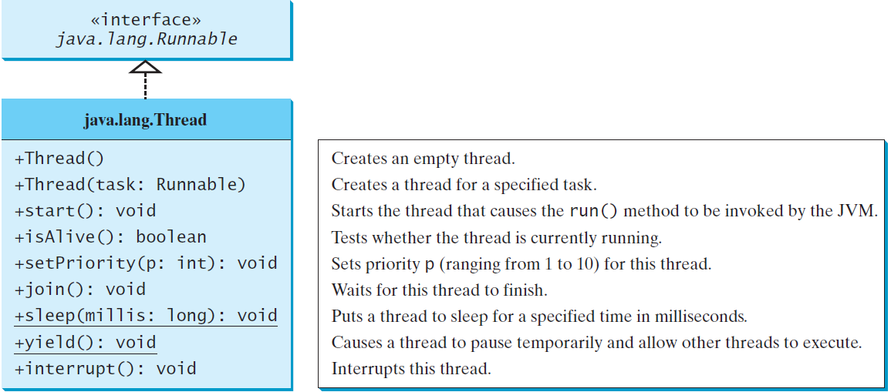

Multithreading
The $Thread$ class contains the constructors for creating threads for tasks and the methods for controlling threads.

Slide 58

Multithreading
You can use the $yield()$ method to temporarily release time for other threads.
Every time a number is printed, the thread of the task is yielded to other threads.
public void run() {
for (int i = 1; i <= lastNum; i++) {
System.out.print(" " + i);
Thread.yield();
}
}

Slide 59

Multithreading
The $sleep\left(long millis\right)$ method puts the thread to sleep for a specified time in milliseconds to allow other threads to execute.
Every time a number (>= 50) is printed, the thread of the task is put to sleep for 1 millisecond.
The sleep method may throw an $InterruptedException$, which is a checked exception.
public void run() {
try {
for (int i = 1; i <= lastNum; i++) {
System.out.print(" " + i);
if (i >= 50) Thread.sleep(1);
}
}catch (InterruptedException ex) {
}
}

Slide 60
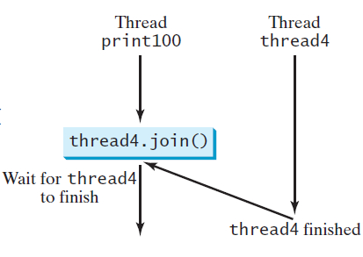

Multithreading
The $join()$ method to force one thread to wait for another thread to finish.
A new $thread4$ is created and it prints character c 40 times. The numbers from 50 to 100 are printed after thread thread4 is finished.
public void run() {
Thread thread4 = new Thread( new PrintChar('c', 40));
thread4.start();
try {
for (int i = 1; i <= lastNum; i++) {
System.out.print (" " + i);
if (i == 50) thread4.join();
}
} catch (InterruptedException ex) {
}
}

Slide 61
Summary
We reviewed the following
Loops
Methods
Arrays
Objects and Classes
Exceptions
Text I/O
Binary I/O
Multithreading

